Slide 1
INTERNATIONAL Health systems
Lloyd Brodsky
Jay shiver

Slide 2
Let’s compare universal health insurance
Jay will talk about what they have in common
Lloyd will talk about how they differ

Slide 3
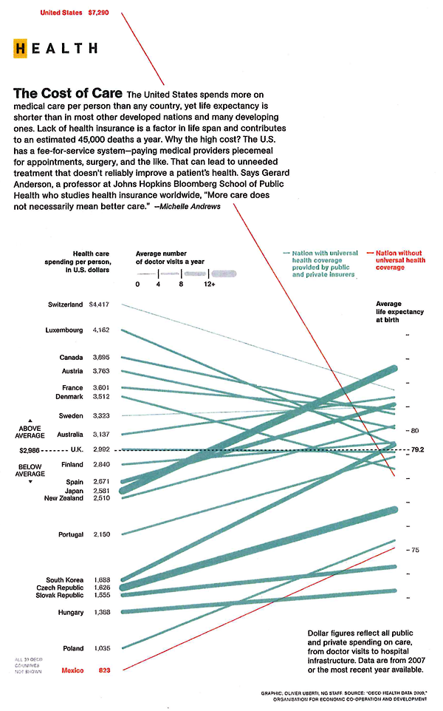

Slide 4
What do they have in common?
Broad-based consumer satisfaction and acceptance by both patients and providers
  https://www.commonwealthfund.org/publications/journal-article/2013/apr/analysis-survey-data-11-countries-finds-satisfaction-health
Cost less but higher overall tax load
  Your slide(s)
Enrollment mandates, aggressive negotiating with pharma, and siting & price controls
  Paid for by taxes
Limitation on choice
  Everybody has a NICE a cost-effectiveness test
    That means emergencies and life-saving treatment takes priority over elective care
  Everybody requires referrals to specialists
Notes:
Jay:
This is your section, so these are just suggestions
I thought satisfaction and acceptance are two different things, especially when it comes to providers
I think one would be amiss not to mention that countries the universal health usually have a higher overall tax load
The aggressive negotiating with pharma is somewhat different than having a NICE. Also most of these government are involved in financing construction, not just giving permission to build
Finally on the NICE business I thought mentioning that non-emergency non-life extending care gets short shrift in underresourced systems is important

Slide 5
Examples from around the globe
Notes:
Do note , of course, that the US is very open only if you have health insurance… And then there is the Medicaid access problem
Also label cost as percentage of GDP. Doesn’t everybody in the first world have an aging population. This is the first time I’ve seen Turkey on a list like this. Why did you pick that one? (just curious)

Slide 6
How do they differ?
What are you signing up for?
How is it funded?
What’s the escape hatch?

Slide 7
Differences in what you ARE signing up for?
Single payer terminology is misleading – universal health coverage is better
Single PROVIDER system (eg NHS)
  Like VHA or Kaiser – the clinicians are all employees
Single payer system (eg France)
  Health care identity card with billing going to government accounts
Regulated multipayer system (eg Germany and Singapore)
  Wide range of insurers, all with a standardized base offering

Slide 8
HOW IS universal coverage FUNDED?
General revenue (e.g. UK and Canada)
  Tends to obscure cost especially in federal countries – what share of your tax bill(s) goes to healthcare
Dedicated taxes, usually payroll (e.g. France, and Germany)
  For example, Germans pay 18% on first 50K split between employer and employee
Premiums and copays
  Lower than they would be in the United States
  Often varies with consumer choice annual deductible and beds in the hospital room
Price controls and “free” real estate

Slide 9
What’s an escape hatch?
It’s virtually certain that any particular menu of benefits will not meet everybody’s needs or wants
People with some combination of will and money will try to escape the restrictions
  Non-emergency non-lifesaving care often has a queue
    Joint replacements, cataracts, diagnostic tests thought unnecessary
  Expensive drugs thought not cost-effective by the local NICE
  Simple convenience
  Really sick children
Most governments have chosen to have an escape hatch to release the pressure
  Quebec doesn’t but they have Chaoulli v. Quebec and the United States

Slide 10
Varieties of escape hatches
Transborder travel
  European Union EHIC card lets you use go anywhere in the EU
  90% of Canadians live within 100 miles of the US
Parallel private insurance and/or balance billing permitted in many countries
  Private insurance as employee benefit in UK
  Parallel private system in Germany available for affluent persons
Optional extras and/or reference pricing
  Many countries (eg Netherlands) allow insurance companies to offer riders extending the mandatory basic plan
  Others (eg South Korea) pay for a basic service and the hospital either sells optional extras or lets freelancers you can enhance with your own money

Slide 11
Discussion questions
Why do many Americans trust the VHA and Medicare but hate the idea of government health care?
So if there is government-funded health care what happens with reproductive care and the Hyde amendment?
What would need to be in a universal health plan to make it palatable to providers and pharma?
How portable are these other system concepts?
What models would be acceptable in this country?
Is everything you’ve heard about universal coverage true?
What role should our government play? And at which levels?
How can HIT have a role in these other systems?
Notes:
So I added my typically provocative questions to your list. This needs to get trimmed.

